Slide 1

INC300
Week 1
Intro + History of Social Media
Amanda Piche, PhD Candidate
May 24th, 2018

Slide 2
Today’s Agenda
Introductions
Lecture Part I: What Is Social Media?
Lecture Part II: The History of Social Media

Slide 3


Slide 4
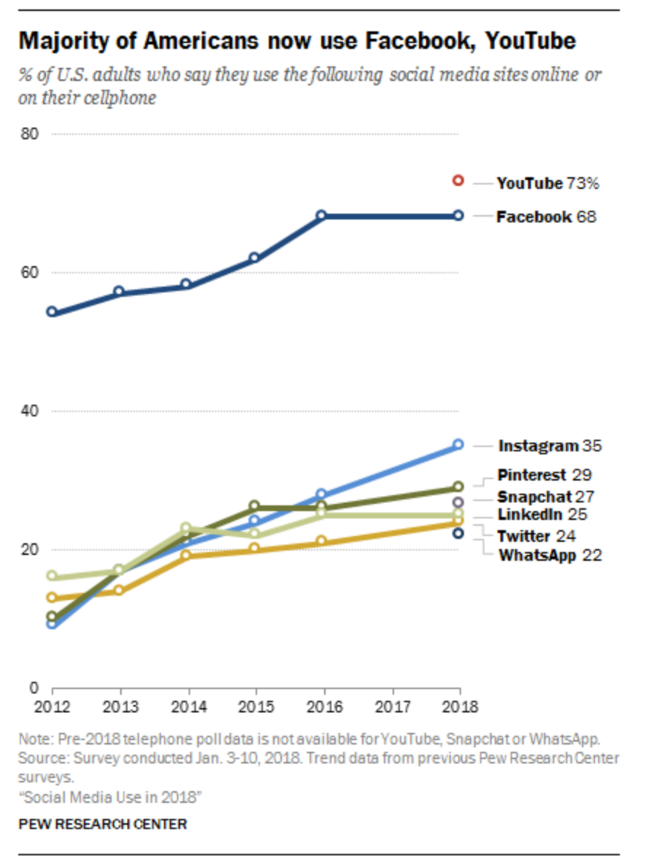
Social Media Use in 2018
Notes:
Source: http://www.pewinternet.org/2018/03/01/social-media-use-in-2018/
A new Pew Research Center survey of U.S. adults finds that the social media landscape in early 2018 is defined by a mix of long-standing trends and newly emerging narratives.

Slide 5
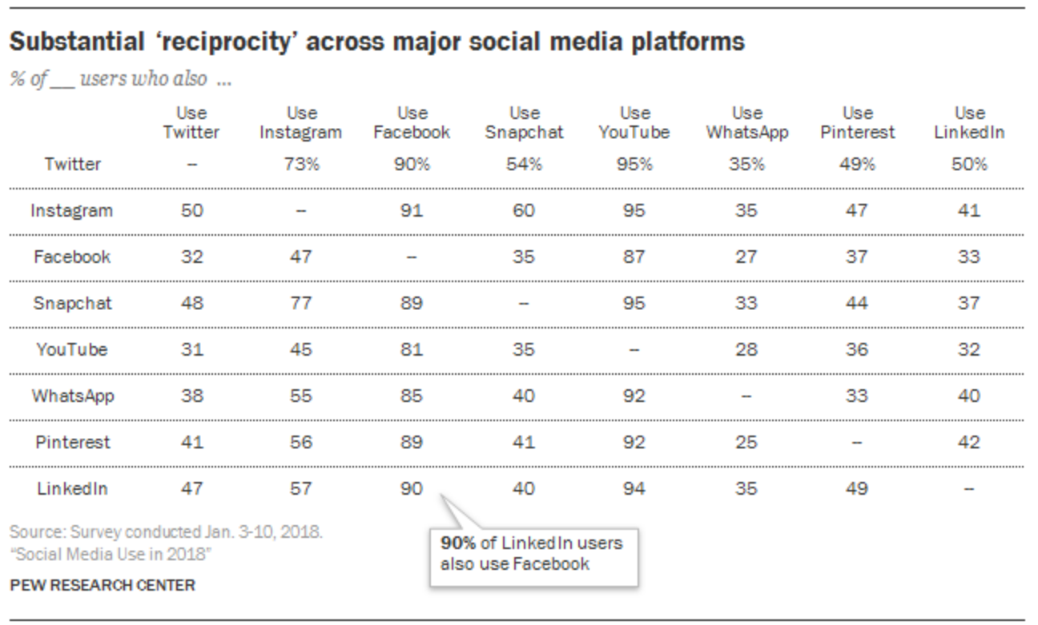
Social Media Use in 2018
Notes:
Source: http://www.pewinternet.org/2018/03/01/social-media-use-in-2018/
This overlap is broadly indicative of the fact that many Americans use multiple social platforms.

Slide 6
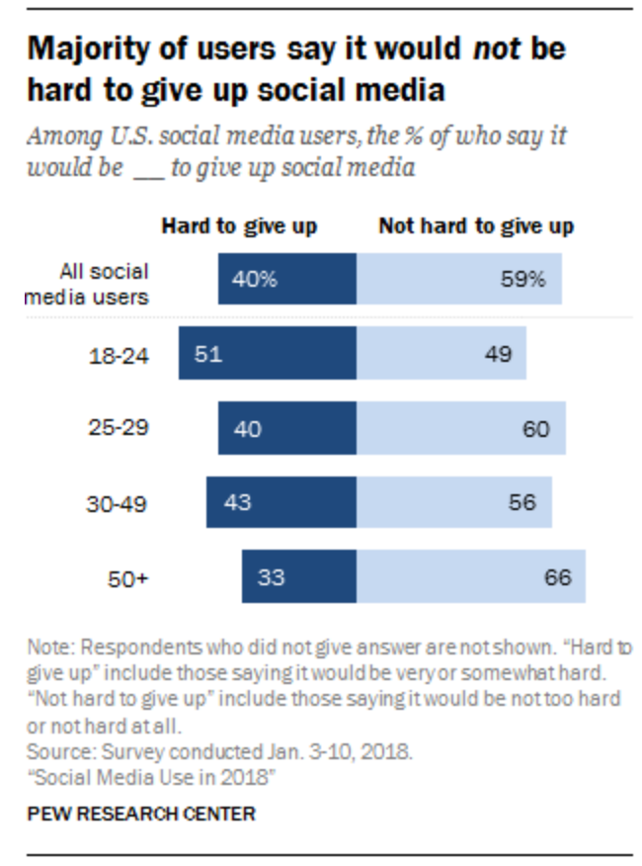
Social Media Use in 2018
Notes:
Source: http://www.pewinternet.org/2018/03/01/social-media-use-in-2018/
Even as a majority of Americans now use social platforms of various kinds, a relatively large share of these users feel that they could give up social media without much difficulty.

Slide 7
Course Description
Every day, millions of people share their opinions with a global audience via Tweets, #s, blogs, wikis, videos, likes, tags, text messages and online comments. Digital spaces and mobile technologies allow us to be connected to our personal and professional networks and communities 24/7. In what ways does this hyper-connectivity impact the ways in which people regard their place in the world and define themselves? In this course we will analyze the social, ethical, political and cultural ramifications of societies that are increasingly mobile and digital. The impact of new genres and forms of expression on our identities will be explored as we actively participate in online networks and create materials for social media.

Slide 8
Course Learning Outcomes
Examine the impact of social media and digital spaces on the concept and expression of identity.
Explore the ways the structure and dynamics of networks affect the behaviors of individuals and populations.
Analyze perspectives on social media practices in order to make judgments about the ethical and responsible use of social media.
Discuss ways to protect privacy and maintain control over personal information.
Explore web tools and social platforms to determine the options they enable for connection, interaction and participation in local and global communities.
Create a digital identity that is authentic and professional.

Slide 9


Slide 10
Course Hashtag: #INC300S18
As part of course contributions, students are expected to utilize Twitter to participate in conversations about each week’s material.
Initial tweets, and two replies are due at set times during the week, and students receive points based on quality of engagement.
Your engagement will be measured by several factors: tweeting out to others is the minimum expectation; replying to classmates, engaging with ideas, and connecting external resources is higher level engagement, worthy of more credit.
You are also encouraged to live-tweet during class. Feel free to tweet things from class you found intriguing or questions that you have.

Slide 11
Lecture Part I: What is Social Media?
Learning Outcomes:
Explain the difference between social media and social networking site.
Describe some of the biological and evolutionary reasons that have lead to the popularity of social media.
Define technopanics and use this information to critically examine sensationalist reporting about social media.

Slide 12
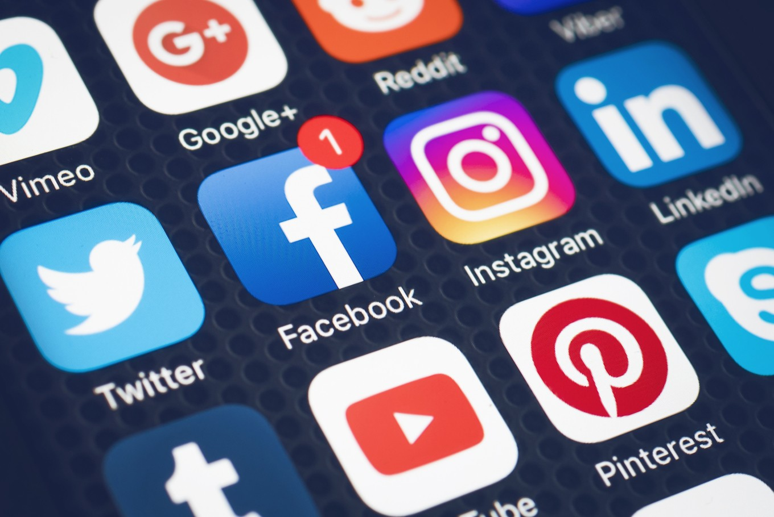
What is Social Media to YOU?
Write down what comes to your mind when you read the term “social media”.
Then, write down your current thoughts about how social media might help (or hurt) you in your workplace or during your search for employment.
At the end of this course you will have the opportunity to revisit your definition and give you the opportunity to reflect on how your understanding of and opinions about social media have evolved.

Slide 13
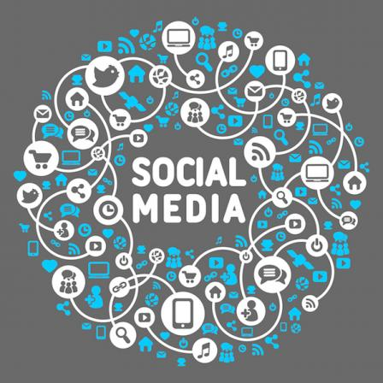
What Do We Mean When We Say “Social Media”?
A social media is anything that allows users to share information (text, audio, images, videos, etc.).
While “social media” might make you immediately think of specific websites like Facebook or Twitter, all media can be social if it allows for the ability to create and maintain a relationship between humans across space and time (Jensen et al 1).
Notes:
Source: Jensen, Klaus Bruhn Social Media and the Struggle for Society. Social Media + Society. 1(1) 1-2.

Slide 14
To be considered a social networking site, the following features MUST be present:
The ability for a user to construct a public or semi-public profile on the website.
The ability to create a list of other users with whom they share a connection.
The ability to view and click on the links of this list of connections (boyd & Ellison p 211).
Notes:
Source: boyd, dana and Ellison. (2007). Social Network Sites: Definition, History, and Scholarship. Journal of Computer‐Mediated Communication, 13(1), 210-230.

Slide 15
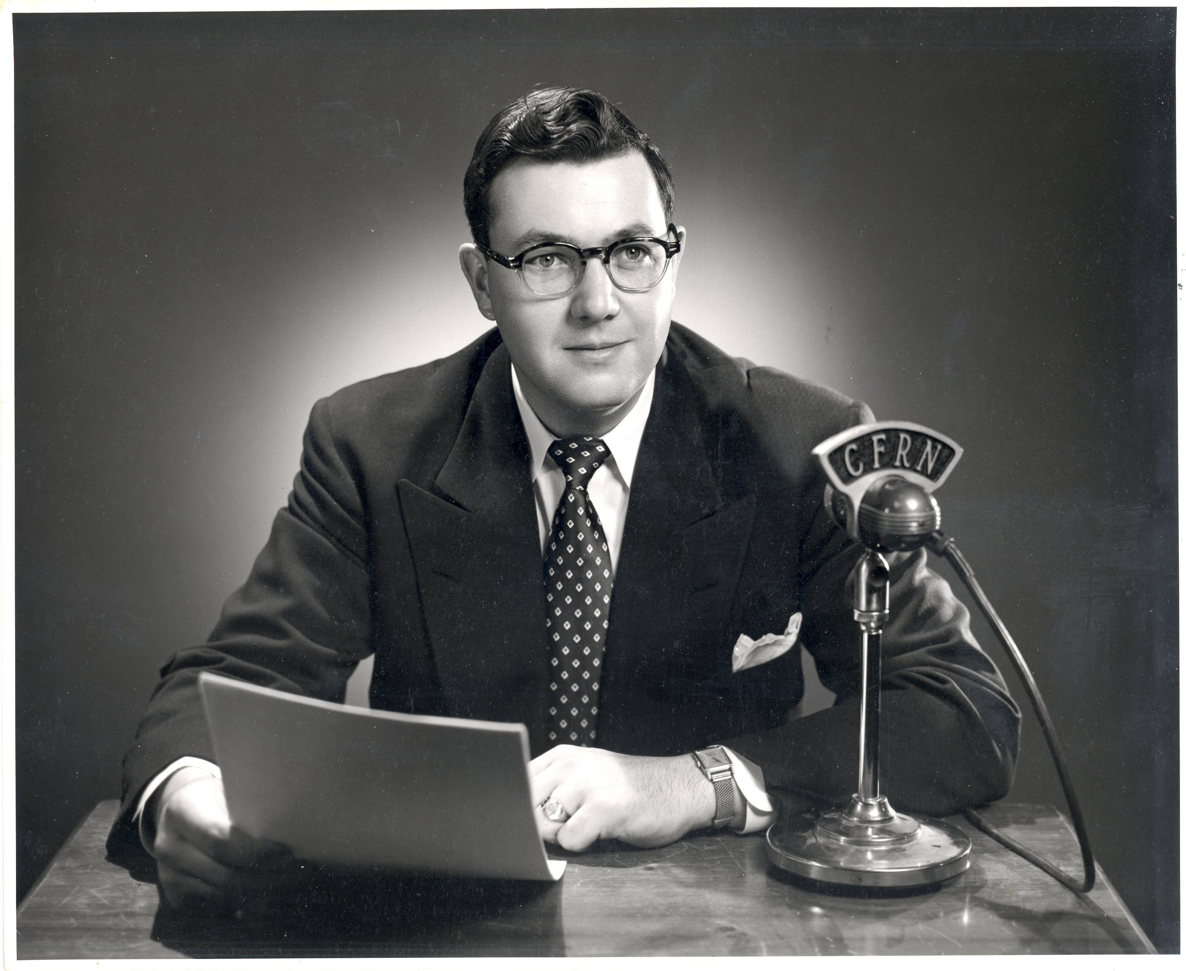
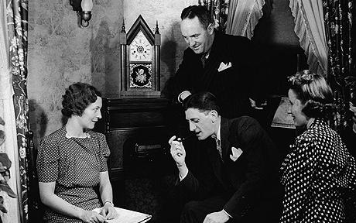
Traditional media
Traditionally, much of the media we consume has taken the form of monologic transmission.
Monologic transmission is one-way communication. There is a single source of the message, but multiple receivers.
Everyone receiving the message gets the same information, there is no individual customization of the message they are hearing, reading, or seeing.

Slide 16
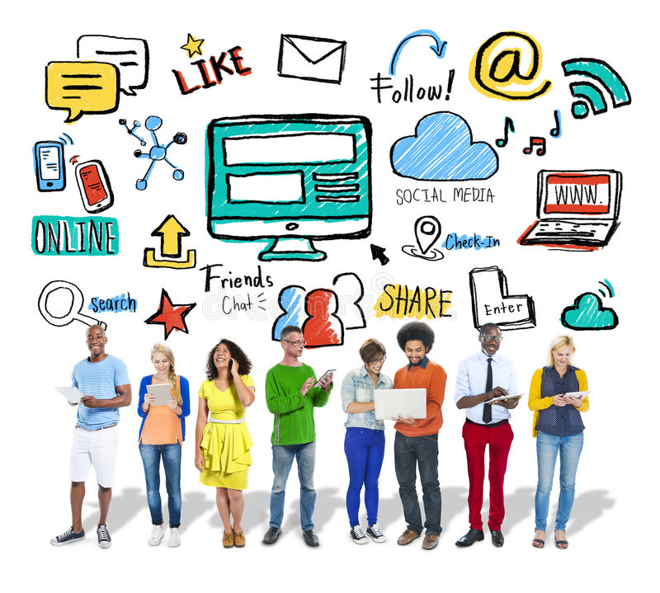
Traditional media vs. Social Media
Social media is a form of dialogic transmission. By participating in social media you become part of the conversation. Rather than only listening to the message, you become both the audience and the speaker.
Social networking sites are a social media because “users of such sites do more than just passively consume information, in other words: they can also create it, comment on it, share it, discuss it, and even modify it. The result is a shared social environment and a sense of membership in a distributed community (Standage 7).”
Social media can also be described as a form of participatory media
Notes:
Source: Standage, Tom. (2014) Writing on the Wall: Social Media – The first 2000 Years. New York, NY: Bloomsbury Publishing.

Slide 17
Web 2.0 and the Rise of Participatory Media
Web 1.0
Web 2.0
In the first version of the Internet (Web 1.0), information was static. This was because websites were coded using HTML, a fairly rigid coding structure that required content and form to be linked. Information flowed in one direction (from the website to the user) very much like the monologic transmission.
The rise of XML and dynamic scripting for websites ushered in the age of Web 2.0. You no longer needed to know how to code HTML to make a website. You also no longer needed to make your own website to share your message to other Internet users. Instead, websites now had the ability to accept user- generated content, such as an individual uploading text and photos to a blogging site like Blogspot or Blogger, or video to a site like YouTube.
Notes:
Hyperlink is: The Machine is Us/ing Us (Final Version)

Slide 18
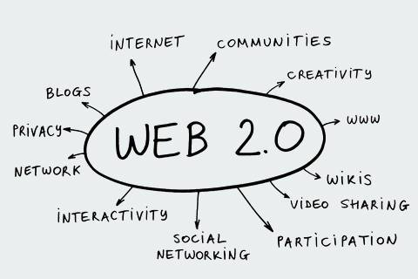
Social networking sites part of Web 2.0
Web 2.0 → applications that allow people to participate in information creation, digital resource sharing, Web page design, and collaboration
Social networking sites are the natural extension of Web 2.0. Not only can users upload their own content to a website, but they are able to share and communicate with other users of that website. Being able to share things that you have made (text, video, images, audio, etc.) can be important way to build an online community with other users who share your particular interests.

Slide 19
We Have Always Been Social
While social networking sites provide an easy means to spread a message to our entire group of friends, humans have always been motivated by a desire to share information with those around us.
Social networking sites are just the most recent iteration of humans finding a way to be social using the tools available to them.
It is important to remember that people have found a way to be social with almost any type of media.
“Any medium that allows people to make meaning together is social. There is nothing more “social” about “social media” than there is about postcards, landline telephones, television shows, newspapers, books, or cuneiform.” (Baym 1)
Notes:
Source: Baym, Nancy (2015). Social Media and the Struggle for Society. Social Media + Society, 1(1), 1-2.

Slide 20
Wired to Be Social
Tom Standage highlights three things that make social media attractive to us (Standage, p 7-8):
Throughout our evolution, we have kept the parts of the brain that have developed to process social information. This allows us to communicate more effectively within group situations. This ability to store information about the people around us is key to our ability to survive (and thrive) as a member of a functional community.
Not only do we store information about the other people around us, we share this information with others to figure out where we fit in the group, but also maintain our place in the group.
Our brains have evolved to store information about the people around us and we have figured out how to use this information to help cement our position in particular groups. The development of writing allows the spread of this information across time and space to share it with people who are not physically present in your immediate area.
Notes:
Source: Standage, Tom. (2014) Writing on the Wall: Social Media – The first 2000 Years. New York, NY: Bloomsbury Publishing.

Slide 21
Wired to Be Social
In sum, according to Tom Standage, we observe things about the people around us and we can use this information about others to help ourselves. Once written language was developed we were also able to share this information with people not in our immediate area, or we can write it down to share at a later point in time. Social media - and social networking sites - allow us to do all three things.
Notes:
Source: Standage, Tom. (2014) Writing on the Wall: Social Media – The first 2000 Years. New York, NY: Bloomsbury Publishing.

Slide 22
Is Social Media Making Us Less Social?
Dr. Sherry Turkle asks us to consider if the interactions we are having via social media have lead to decline in face to face conversations (see her TED talk). Turkle’s worry is that the ease of social media has created a false sense of community, and that our online communications are sanitized, shallow, or “not real”.
When we communicate electronically, we have the ability to edit and craft our message until it is “just right”. Similarly, we can edit and modify our online presence on our social networking profiles in order to create the best version of ourselves to present to the world. This brings up questions surrounding identity and authenticity in an online space.

Slide 23
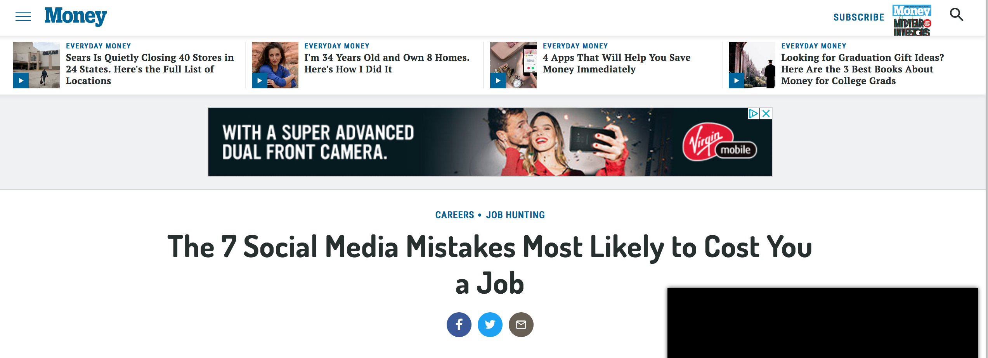
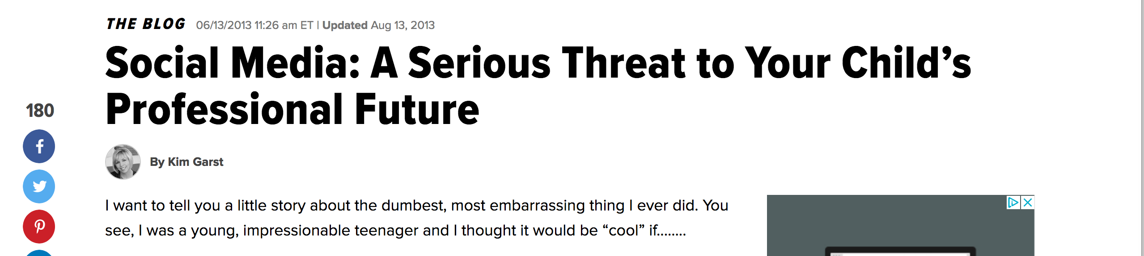
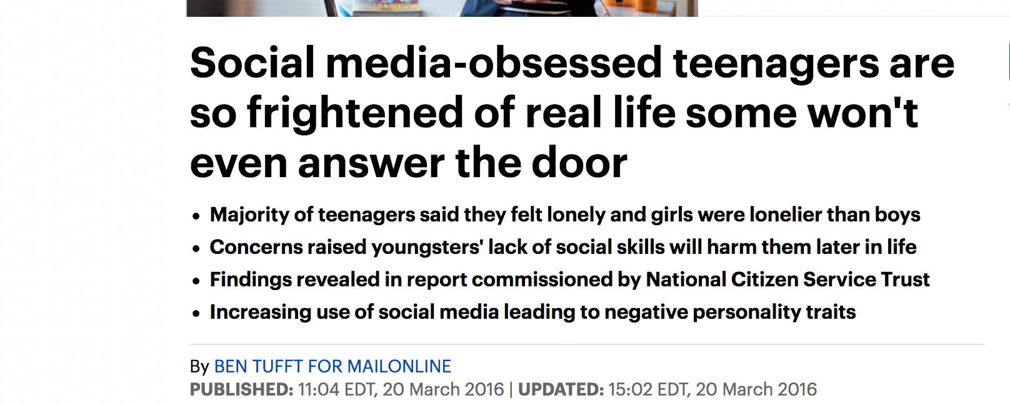
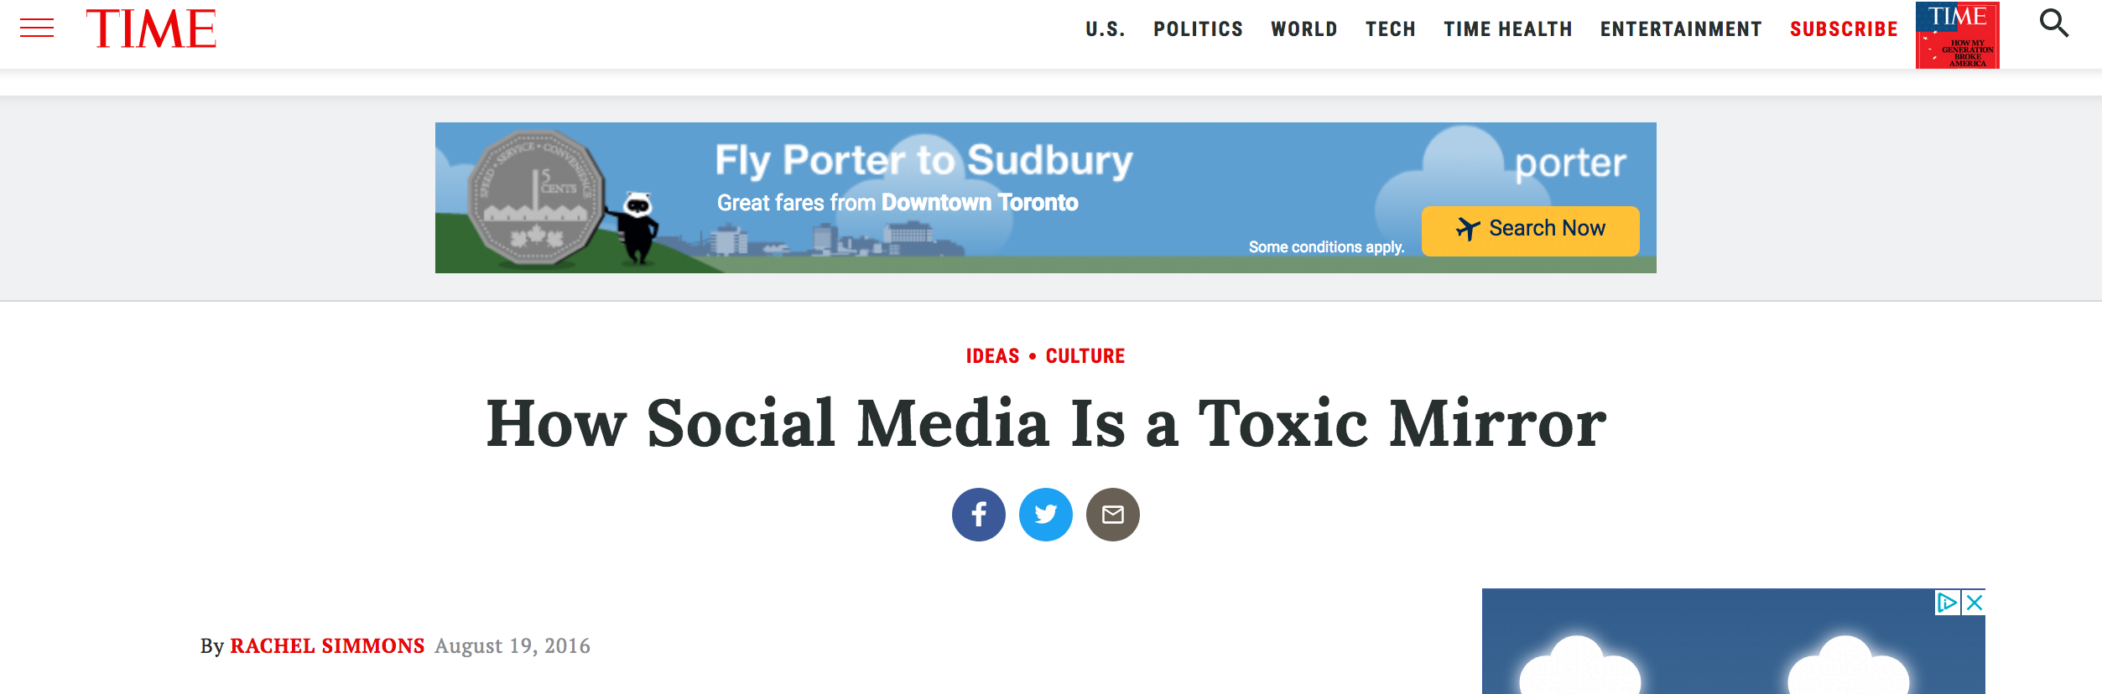
Notes:
These sensationalist headlines are often the result of a technopanic or a technology-focused moral panic.

Slide 24
Moral Panics and Technopanics
A moral panic is a widespread fear about a group of “deviants” who display behaviour that threaten mainstream social values and interest. This group of deviants becomes a scapegoat or a “folk devil” and come to bear the brunt of the blame for social problems.
Summarizing the work of Goode and Ben-Yahuda (1994), Alice Marwick identifies five defining characteristics of a moral panic:
  Concern: there is a heightened level of concern over the behavior of a certain group of people and the harmful effects they will have on the rest of society.
  Hostility: The group is “collectively designated as the enemy” and viewed as evil, anti-social, and deviant
  Consensus: A majority of population must believe that this is a real threat
  Disproportionality: The level of concern is not justified by empirical evidence; that is, the actual threats are minor (if they even exist at all)
  Volatility: Moral panics capture widespread attention very quickly, and then fade out after a period of time.

Slide 25
Moral Panics and Technopanics
Alice Marwick, a communication scholar, has extended this work to technology. Technopanics are a way of understanding a moral panic surrounding a fear over a new technology and its possible negative effects on youth. Technopanics have the following characteristics:
  A focus on a new or emerging form of media;
  Pathologizing (treating it as unhealthy and abnormal) young people’s use of this media;
  An attempt to regulate young people’s behaviour by controlling their access to this new technology.
Is Turkle exhibiting technopanic?

Slide 26
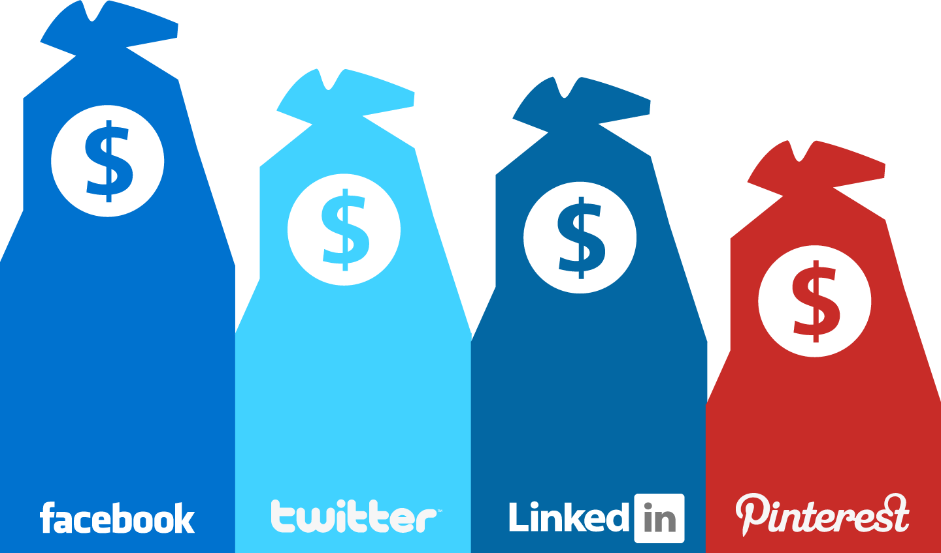
The Business of Social Media
Why is social media free to access? Answer: advertising.
The social interactions that are facilitated through these networking sites are a result of private companies figuring out how to harness what people were already doing (i.e. using the Internet to talk to each other), streamlining the process (i.e. creating an easy to use website), and turning it into a revenue stream (Baym 1).
Facebook is able to make billions of dollars a year because it harnesses the information we share about ourselves, and uses this to sell us advertising.
Not only do you tell Facebook things about you, you also tell it who your friends are. By mapping out your network of friends and professional connections, this helps to further refine advertiser’s efforts to reach their target demographics.

Slide 27
Lecture Part I: What is Social Media? Summary
We have explored:
The definition of social media, and how it relates to social networking sites (e.g. Facebook, Twitter, Pinterest).
Two types of knowledge transfer (monologic and dialogic).
The biological and evolutionary factors that have contributed to the popularity of social media.
Technopanics, and how this can be a framework to unpack sensationalist reporting about social media.
Issues surrounding privacy and how our personal data can be monetized by social networking sites.

Slide 28
Lecture Part II: History of Social Media
Learning Outcomes:
List examples of Web 1.0 technologies that could be considered social media.
Use examples of Roman communication practices that meet the definition of “social media”.
List examples of social networking sites that pre-date Facebook.

Slide 29
Remembering the Roots of Social Media
Recall the shift from Web 1.0 to Web 2.0. This shift has allowed social networking sites to flourish, but this should not be taken as a message that Web 1.0 was not social. It is important to not retroactively apply current popular definitions of social media to previous technologies that existed pre-social networking sites. By doing so, we inadvertently erase the long history of social media.
Examples of Web 1.0 being used for social media include:
Computerized bulletin board systems (Usenet, Fidonet)
Synchronous online chat (e.g. Internet Relay Chat)
E-mail lists
‘Static’ web pages fairly easy to write, encouraged webzine culture

Slide 30
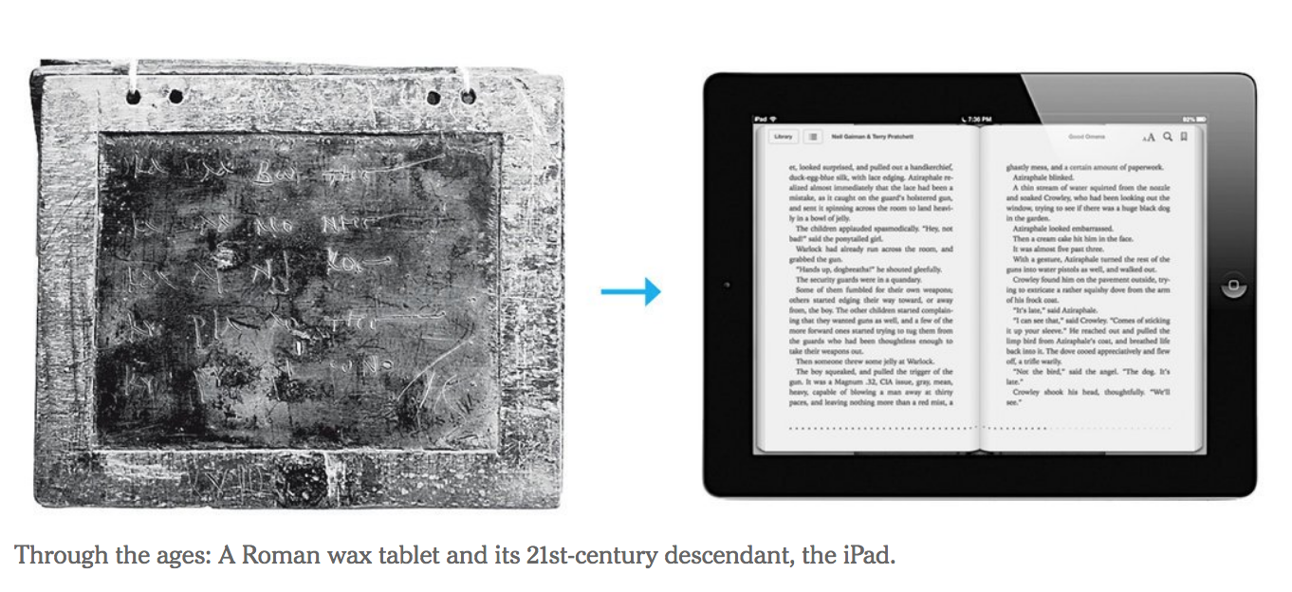
Social Media: A Historical Perspective
Tom Standage, The Writing on the Wall: Social Media - The First Two Thousand Years
  Asks the question: what if new media aren’t as new as we assume — and old media not really old at all?
  Argues that social media is not new, and that we have always found a way to spread our messages and ideas with the prominent technologies of the time.
  Makes a convincing argument that Romans living in first century B.C. were some of the very first users of social media

Slide 31
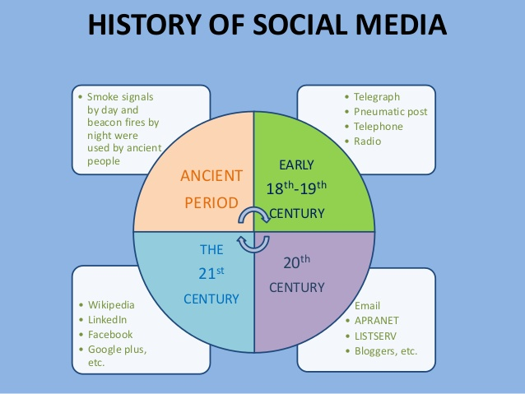
Social Media: A Historical Perspective
Tom Standage, The Writing on the Wall: Social Media - The First Two Thousand Years
  Main takeaway: Social media, whether of the digital or the preindustrial variety, fill a universal human need for connectedness, for self-­expression and for information-sharing. This need is as old as language itself — which suggests, if nothing else, that satisfying it digitally won’t leave us emotionally crippled after all.

Slide 32
A Brief History of Social Networking Sites
“Many social networking sites were created in the 1990s. Some examples include Six Degrees, Black Planet, Asian Avenue, and Move On. These are, or have been, online niche social where people can interact, including sites for public policy advocacy and a social network based on a web of contacts model. In addition, blogging services such as Blogger and Epinions were created. Epinions is a site where consumers can read or create reviews of products. ThirdVoice and Napster were two software applications created in the 90s that have since been removed from the market. ThirdVoice was a free plug-in that allowed users to post comments on webpages. Opponents of the software argued that comments were often vulgar or slanderous. Napster was a software application that allowed peer-to- peer file sharing. Users were allowed to share music files bypassing normal distribution methods, which in the end was determined to be a violation of copyright laws” (Ritholz, 2010).
“In 2000 social media received a great boost with the witnessing of many social networking sites springing up. This highly boosted and transformed the interaction of individuals and organizations who shared common interest in music, education, movies, and friendship, based on social networking. Among those that were launched included LunarStorm, six degrees, cyworld, ryze, and Wikipedia. In 2001, fotolog, sky blog and Friendster were launched, and in 2003 MySpace, LinkedIn, lastFM, ribe.net, Hi5, etc. In 2004, popular names like Facebook Harvard, Dogster and Mixi evolved. During 2005, big names like Yahoo!360, YouTube, cyword and Black planet all emerged (Junco, Heibergert, & Loken, 2011).” (Edosomwan et al, 2011, p. 81)
Notes:
See: https://www.emarketeers.com/e-insight/social-media-infographic-illustrating-the-history-of-social-media/ & https://spectrum.ieee.org/computing/networks/social-networking-friended
Ritholtz,B. (2010, December 2). “History of Social Media”. The Big Picture. Available: http://ritholtz.com/2010/12/history-of-social-media/
Edosomwan, S. Prakasan, S.K., Kouame, D. Watson, J., & Seymour, T. (2011). “The History of Social Media and its Impact on Business”. Journal of Applied Management and Entrepreneurship. 6(3), 79-91.

Slide 33
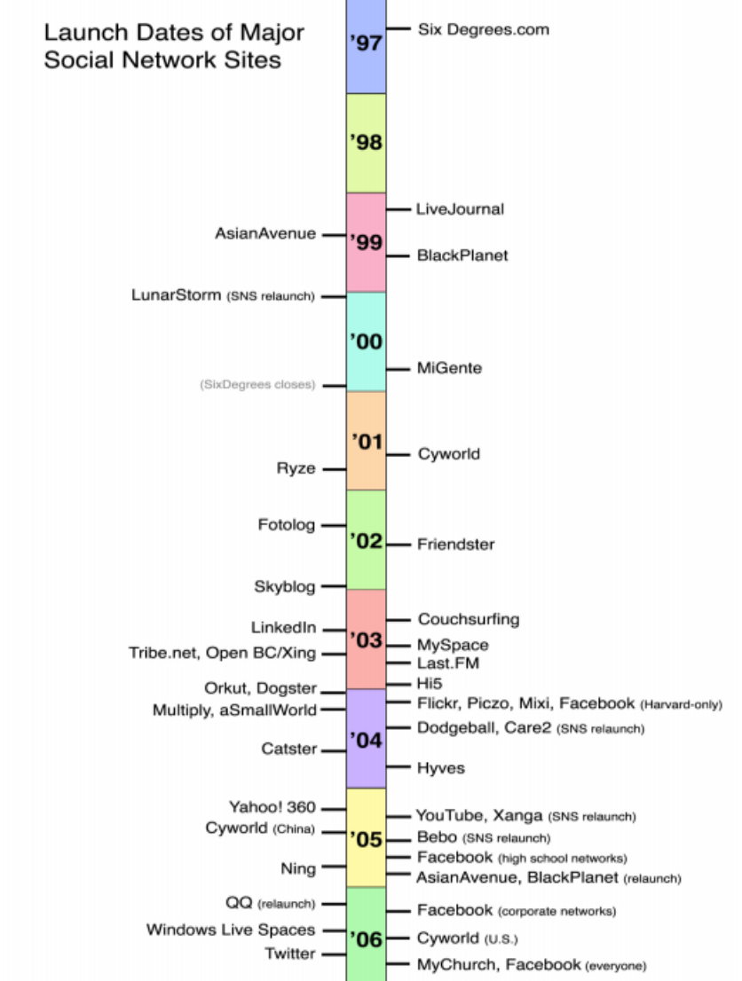

Slide 34
A Brief History of Social Networking Sites
When looking back on the history of social networking sites, a few “big names” stand out: Sixdegrees, Friendster, MySpace, Facebook.
Each of these new sites filled a gap left open by their predecessor. Sixdegrees did not offer users the ability to post photos, but this is something that could be done on Friendster. The ability to post photos was attractive enough to draw large numbers of users to Friendster, but then the slow website response time meant that users were on the look out for another responsive site, which paved the way for MySpace. The final migration of users leaving MySpace in favour of Facebook because it took to heart the lessons of its predecessors’ mistakes and through innovative features, easy-to-use interface and engineering wizardry.
Notes:
See: https://spectrum.ieee.org/computing/networks/social-networking-friended

Slide 35
Lecture Part II: History of Social Media Summary
We have explored:
The ways Web 1.0 technologies were used as a form of social media.
The Ancient Roman social media ecosystem, which serves as an example of social media that predates the Internet.
A brief history of social networking sites, highlighting that long before Facebook, sites existed that met the definition of a social networking site.

Slide 36
For next week:
Next week’s class (May 31st) will be online!
Lecture material will be made available online and must be read before 7pm on May 31st.
At 7pm, students must be online on Blackboard and participate in an online discussion. Students must respond to one writing prompt (250 words minimum), and must reply to two of their classmates posts before 10pm.
The instructor will be available at this time to provide clarification and answer any questions by e-mail.

